Slide 1

Data and Business Analytics
for BaSalam e-commerce
2025

Slide 2
TEAM INFO
TEAM 12 | TEAM 12 | TEAM 12
Name | Section | BN
Moustafa Mohammed Elsayed | 2 | 23
Mennatallah Ahmed Moustafa | 2 | 25
Mostafa Hani Mostafa | 2 | 24
Mohammad Alomar | 2 | 14

Slide 3


PROJECT GOALS
Predict product performance using factors such as price, customer ratings, and weekly sales.
2. Analyze historical data to identify trends and insights influencing product success.

Slide 4
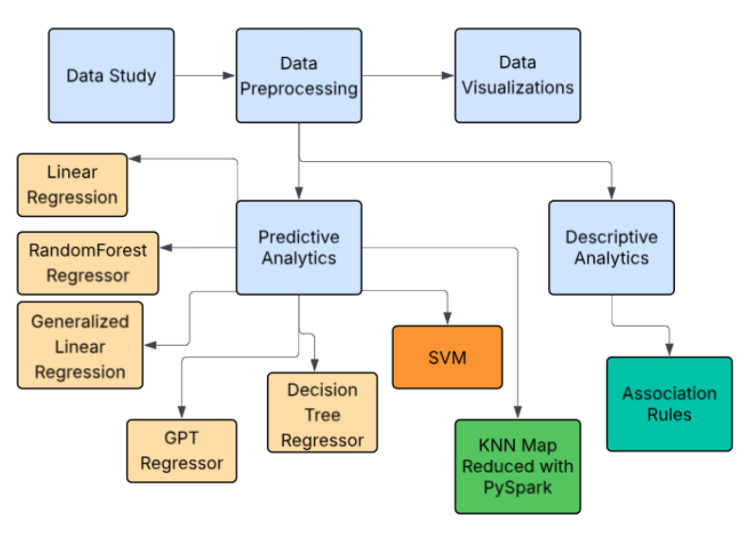
PROJECT PIPELINE

Slide 5


Detailed Analysis
Business Analysis
Technical Analysis

Slide 6
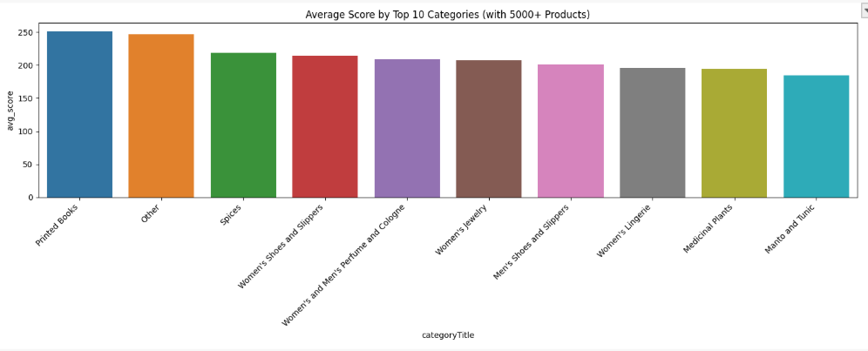
CATEGORY ANALYSIS
Having a product in one of these categories leads to better score

Slide 7
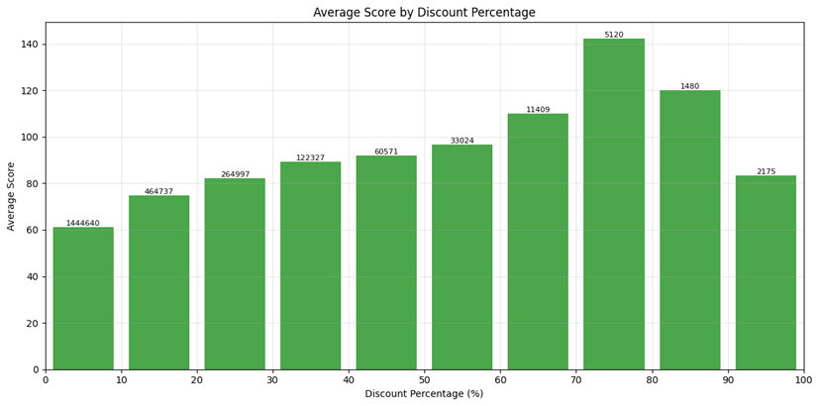
DISCOUNT ANALYSIS
Increasing discounts make products appear more valuable "good deal"
Maximum satisfaction around 70-80% discounts
Extreme discounts (especially 90-100%) trigger skepticism:
Customers suspect products being defective/expired, "Too good to be true" mentality

Slide 8
VARIATION ANALYSIS
The average score increases when the product has variations of different sizes/colors
has_variation | average_score
false | 68.169
true | 90.199

Slide 9
WEIGHT VS FREESHIPPING ANALYSIS
High weight means high price which probably has Free shipping
isFreeShipping | average_weight | average_price
false | 2639.84 | 2719.07
true | 3182.76 | 7034.415

Slide 10
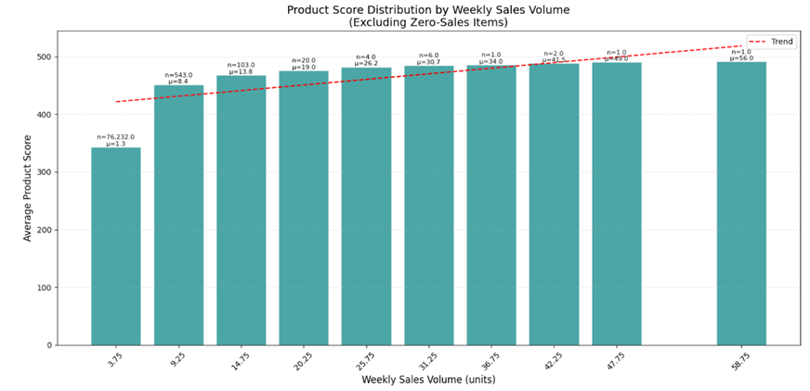
SCORE VS SALES ANALYSIS
Higher weekly sales correlate with better performance scores.

Slide 11
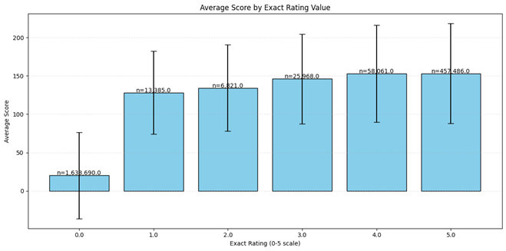
SCORE VS RATING AVERAGE ANALYSIS
Better ratings strongly lead to higher scores.

Slide 12
MEDIA VS HIGH SCORE ANALYSIS
Having a picture and a video for the product achieves the highest scores
has_photo | has_video | average_product_score | product_count
false | false | 18.22 | 524
false | true | 13.88 | 6
true | false | 68.5869 | 2134613
true | true | 89.282 | 150089

Slide 13

HOW TO HAVE A GOOD PRODUCT?
Select products from categories that consistently have high performance scores.
Apply moderate (not excessive) discounts to attract buyers without devaluing the product.
Offer variations (such as different sizes, colors, or styles) to appeal to a broader audience.
Prioritize maintaining high customer ratings by ensuring quality and excellent service.
Provide high-quality images and videos to showcase the product effectively.

Slide 14

Technical Analysis
>
>
>
Data Preprocessing
Data Visualization
Model Training

Slide 15
DATA PREPROCESSING
Dropping columns with high percent of null values (> 0.8)
Splitting data into train, test
Removing columns that won’t affect the model such as ids, photos URLs ['_id','photo_MEDIUM','vendor_identifier', 'photo_SMALL','vendor_id','vendor_provinceId', 'vendor_owner_id','vendor_status_id','vendor_cityId','vendor_statusId','categoryId','new_categoryId','status_id']
For association rules, we used dropna to drop all rows that have nulls after that we would have
Original row count: 2411358
Rows after removing nulls: 2262039
Removed 149319 rows (6.19% of data)

Slide 16
DATA PREPROCESSING
5. But for the predictive models, we found that the remaining columns have a low percent of nulls (0.2) thus we decided to replace these nulls with a median for numerical columns and mode for categorical, binary columns
6. Dropping categorical columns with very high cardinality before one hot encoding
7. One hot encoding categorical columns
8. Drop very high correlated columns
9. Now all columns are numerical, we Calculate the correlation with each column and target, and select the most correlated columns with the target

Slide 17
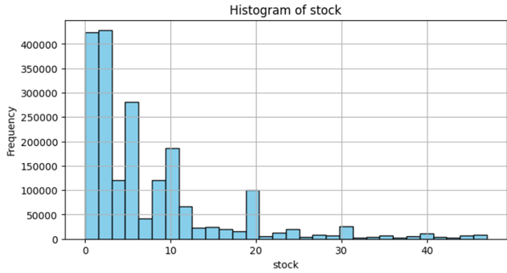
DATA VISUALIZATION
High stock is infrequent

Slide 18
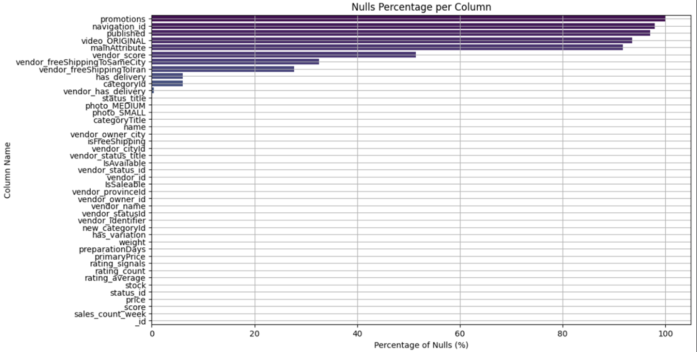
DATA VISUALIZATION

Slide 19
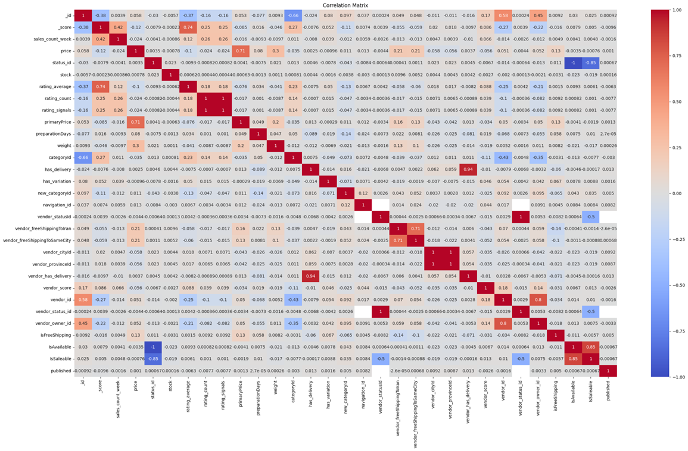
DATA VISUALIZATION

Slide 20
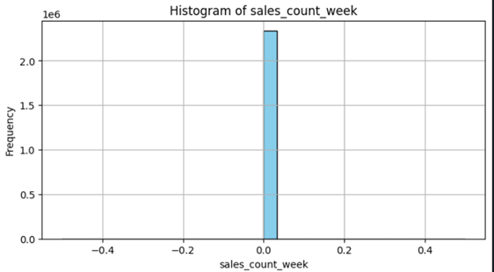
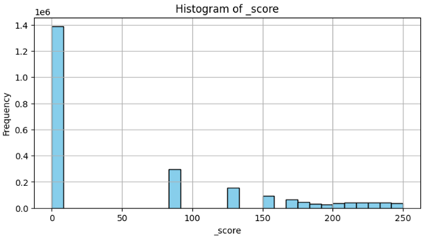
DATA VISUALIZATION
As we can notice the distribution and values of score in the data are better than sales_count_week

Slide 21
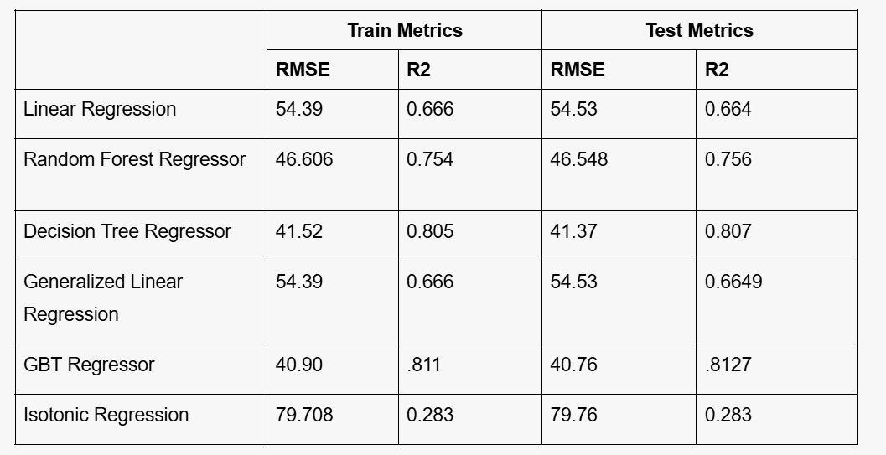
PREDICTIVE ANALYTICS- REGRESSION

Slide 22
PREDICTIVE ANALYTICS- CLASSIFICATION WITH SVM
Validation accuracy for each parameter combination:
MaxIter: 10, RegParam: 0.01, Validation Accuracy: 0.8677
MaxIter: 10, RegParam: 0.1, Validation Accuracy: 0.8677
MaxIter: 10, RegParam: 1.0, Validation Accuracy: 0.8677
MaxIter: 50, RegParam: 0.01, Validation Accuracy: 0.8677
MaxIter: 50, RegParam: 0.1, Validation Accuracy: 0.8677
MaxIter: 50, RegParam: 1.0, Validation Accuracy: 0.8677
MaxIter: 100, RegParam: 0.01, Validation Accuracy: 0.8677
MaxIter: 100, RegParam: 0.1, Validation Accuracy: 0.8677
MaxIter: 100, RegParam: 1.0, Validation Accuracy: 0.8677
Best parameter combination:
MaxIter: 10, RegParam: 0.01, Validation Accuracy: 0.8677
Training Accuracy: 0.8673096628188802
Validation Accuracy: 0.8675115536215187
Test Accuracy: 0.8684010181241871

Slide 23
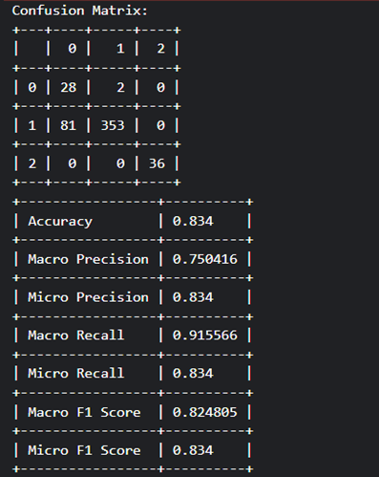
PREDICTIVE ANALYTICS- CLASSIFICATION MAP REDUCE
Map PHASE
Each partition finds its top-most similar neighbors.
Reduce PHASE
Combine neighbors from all partitions.
Sort combined neighbors based on similarity scores and select the top-k global neighbors.
Weighted Voting Prediction
Each neighbor votes for its class label.
Votes are weighted by similarity scores and inverse class frequency to reduce bias toward frequent classes.
Predict the label with the highest total weighted vote.

Slide 24
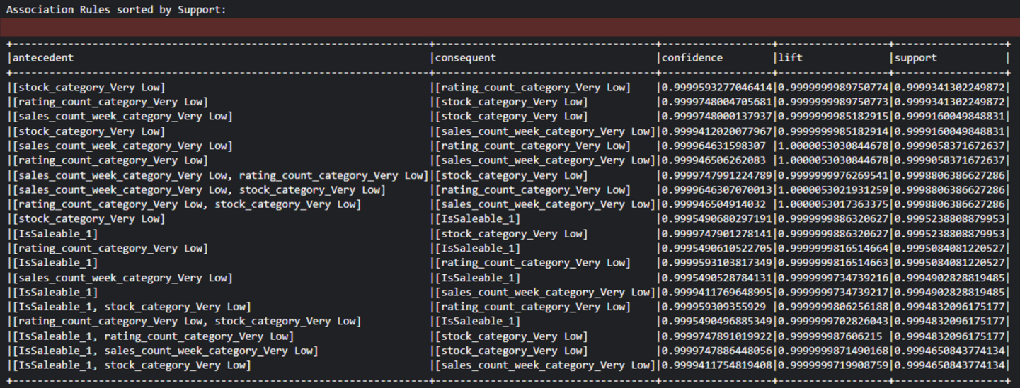
DESCRIPTIVE ANALYTICS- ASSOCIATION RULES
Step 1. Convert numerical columns to categorical
Step 2. Prepare dataframe: Append column name at the beginning of each item in the column to help differentiate values after creating the itemsets
Step 3. Concatenate columns to create item sets
Step 4. Create the Association Rules from the item sets

Slide 25
DESCRIPTIVE ANALYTICS- ASSOCIATION RULES
Interesting Rules:
Products with no ratings tend to have low engagement metrics
Items with rating_average_0.0 almost always have very low sales counts, stock levels, and rating counts
This suggests new or unpopular products need specific attention to gain attraction
Extremely low rating counts and low sales are consistently linked.
Products that have low rating counts tend to have lower sales as the products don’t have feedback so people don’t trust them as much
Low-performing products share a profile of
Low Stock
Low Weekly Sales
Well-stocked products share a profile of
High-priced
Without free shipping
Without variation
Possibly because they're premium, standardized items.

Slide 26

HOME
ABOUT US
MORE
AWS EMR Deployment

Slide 27
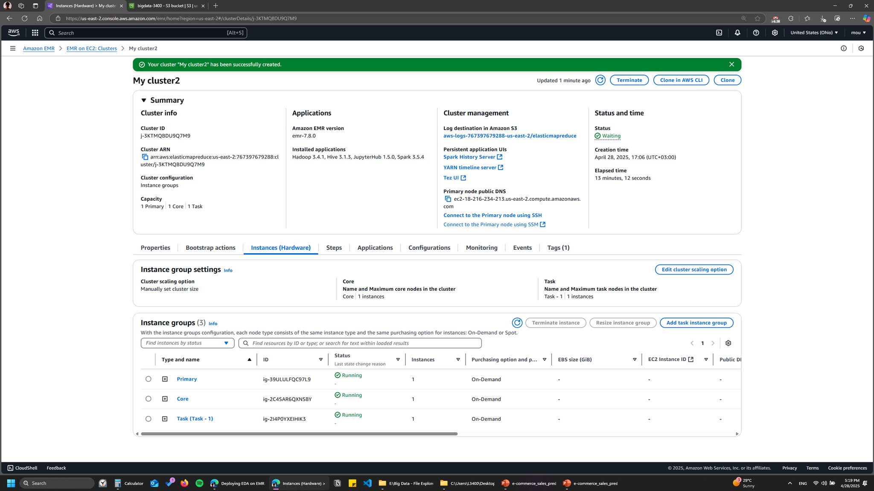
Connected to the cluster and opened jupyter hub
Tested the code on a pyspark jupyter notebook

Slide 28
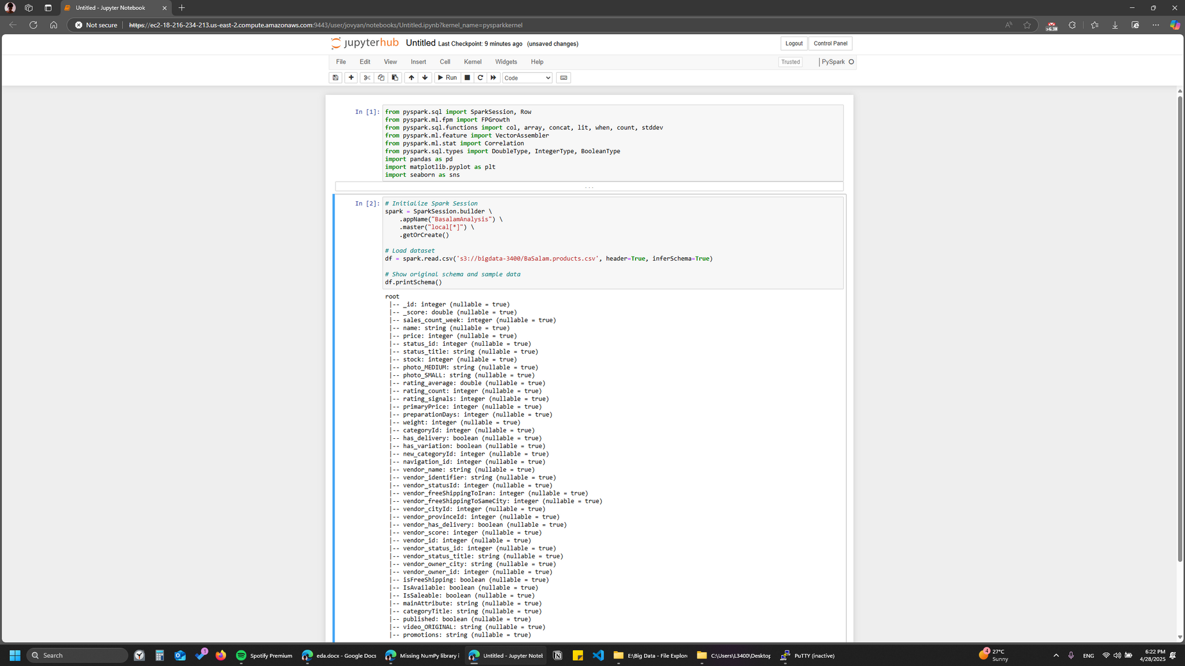
3. Uploaded the dataset into an S3 bucket
4. Created an Amazon EMR Cluster with the following nodes:
1 Primary node
1 Code node
1 Task node

Slide 29
Thank You.

